Slide 1


DATA ENRICHERS
CS 510 Data Engineering
Vehicle Group - Sunny
Portland State University
Computer Science
TRIMET

Slide 2




Bruce Irvin
Instructor
Vysali Kallepalli
Teaching Assistant
Saheli Bavirisetty
Team Member
Srihari Tadala
Team Member

Slide 3
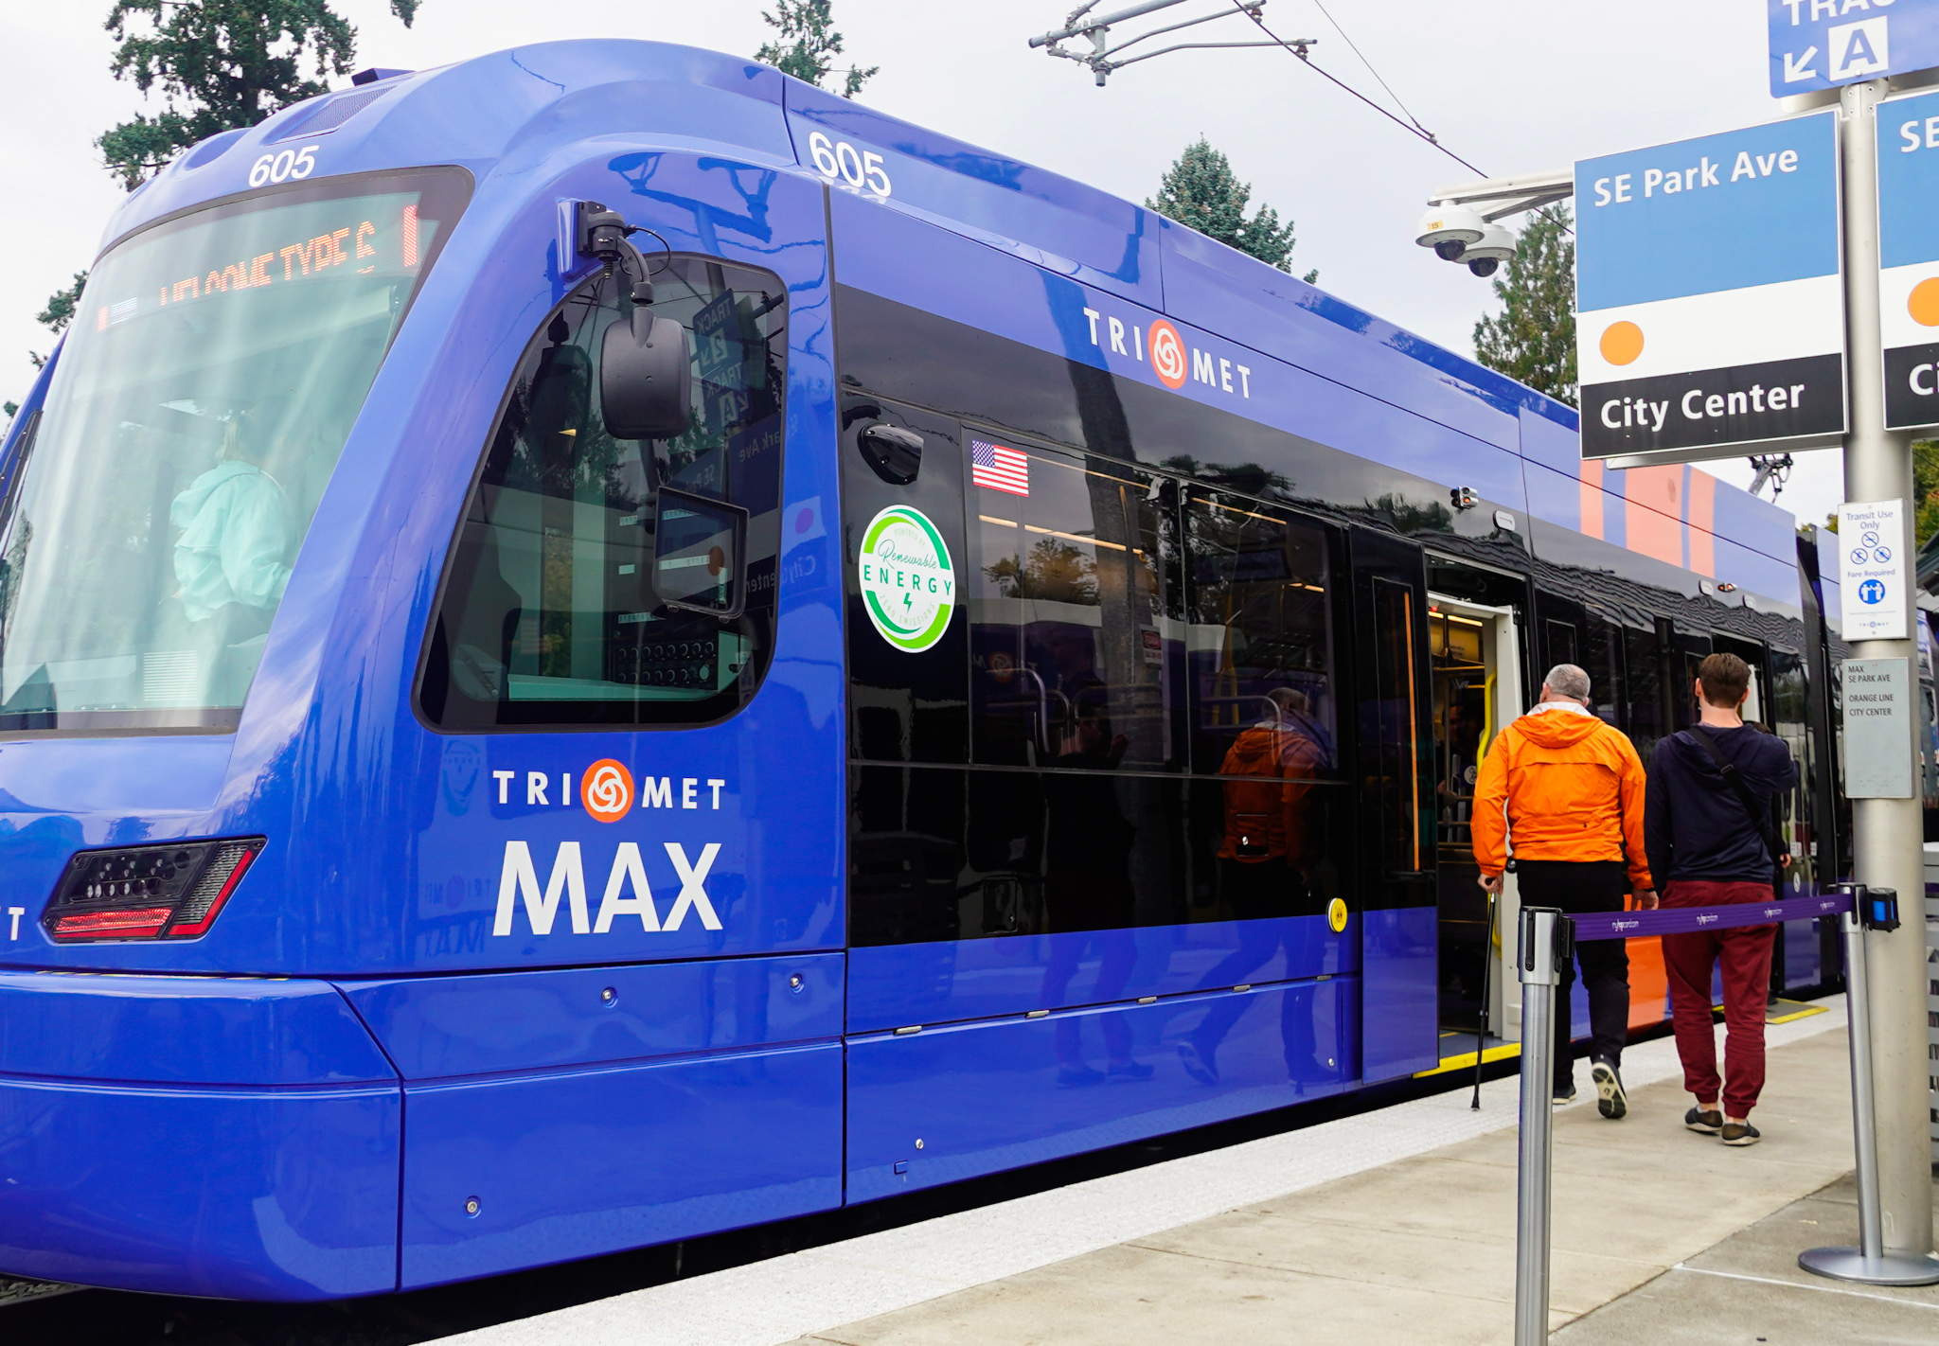

INTRODUCTION
TriMet is a public agency that operates mass transit in a region that includes the Portland metropolitan area. It provides bus, light rail, and commuter rail transit services.
This project uses real-time and historical transit data collected from TriMet's operations to improve public transit services through enhanced data analysis
The main goal is to develop a sophisticated data engineering solution that integrates, processes, and analyzes GPS breadcrumb and stop event data from TriMet vehicles to enhance operational efficiency and service reliability.
Build and optimize data pipelines to handle large volumes of transit data efficiently, integrate different data sources, and develop visualizations that provide actionable insights into transit operations.
By analyzing this data, the project aims to identify areas for improvement in route planning, schedule adjustments, to better manage resources effectively.
Srihari Tadala

Slide 4
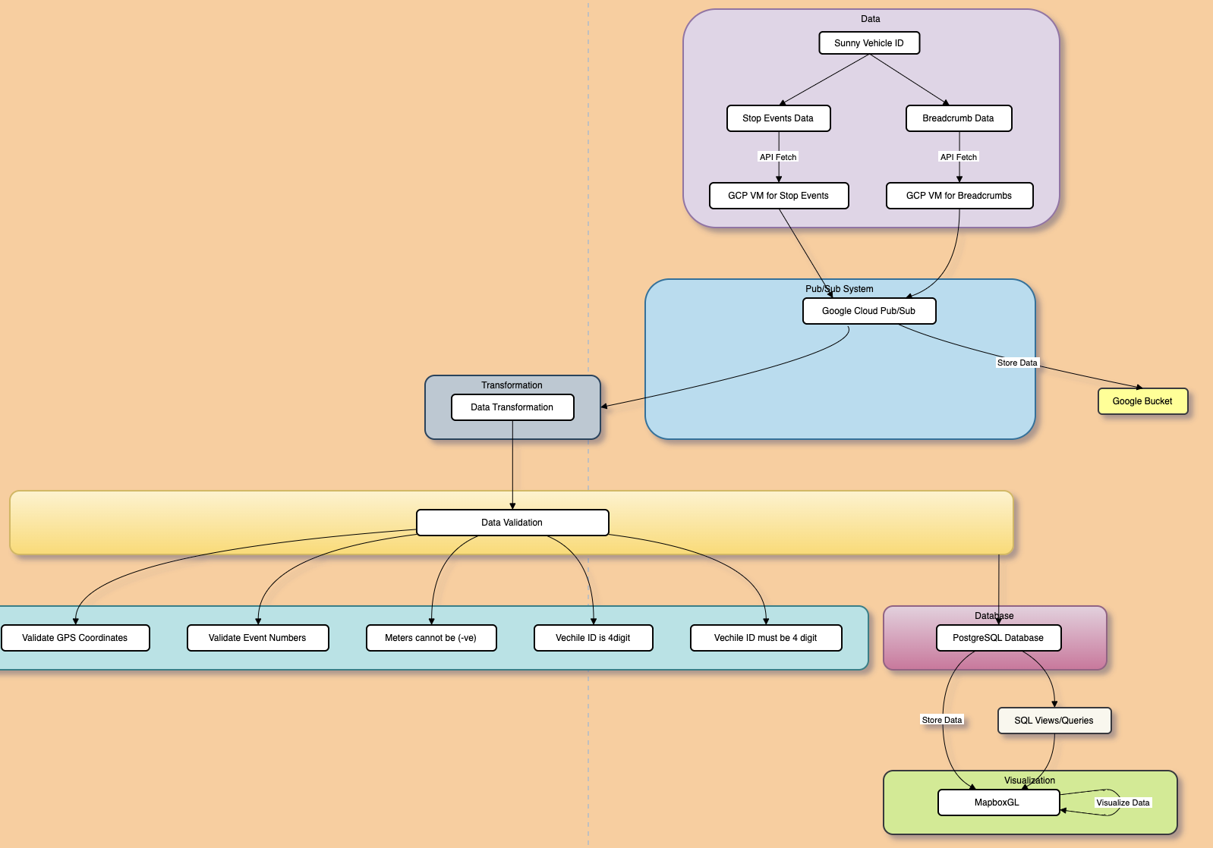




ARCHITECTURE
Srihari Tadala

Slide 5
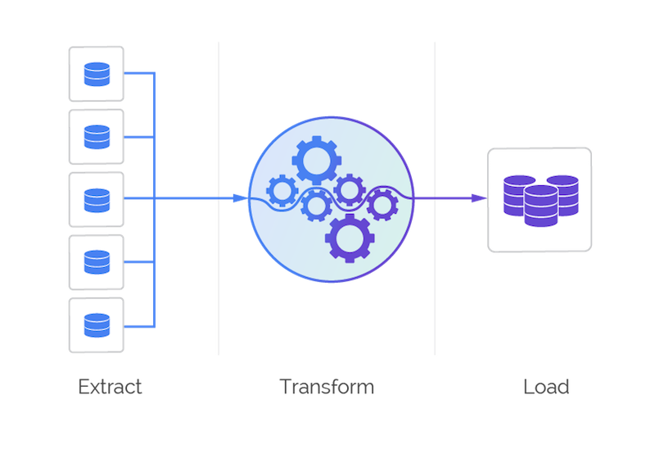

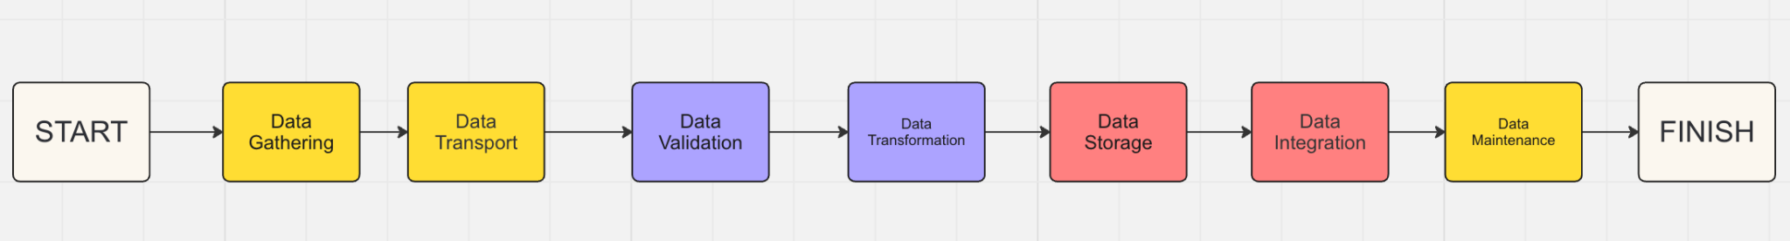
PIPELINE
Srihari Tadala

Slide 6
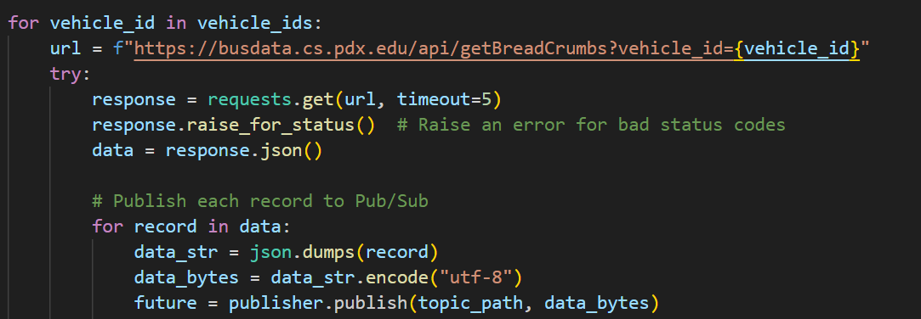
DATA GATHERING
Dynamically constructs URLs to fetch breadcrumb data for each vehicle_id.
Converts each record to a JSON string and encodes it into bytes.
Prepares data for efficient transmission to Google Cloud Pub/Sub
Publishes each record to a specified Pub/Sub topic using Google Cloud Pub/Sub client library.
Srihari Tadala

Slide 7
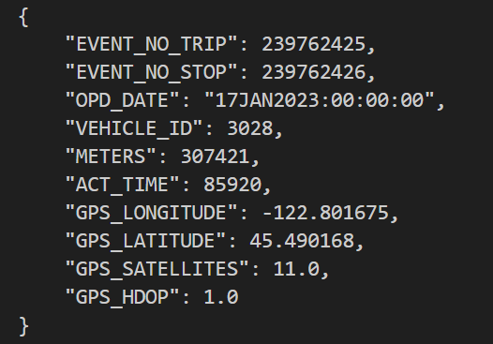
BREADCRUMB DATA
Each breadcrumb record is uniquely identified by an 'EVENT_NO_TRIP' and 'EVENT_NO_STOP', linking it to specific trips and stops.
Data includes 'OPD_DATE' showing the date of operation, and 'VEHICLE_ID' which specifies the bus or vehicle.
METERS shows the distance the vehicle has traveled, and 'ACT_TIME' provides the time in seconds since midnight at which the data was recorded.
Geographical coordinates are given by 'GPS_LONGITUDE' and 'GPS_LATITUDE', along with 'GPS_SATELLITES' indicating the number of satellites connected.
GPS_HDOP (Horizontal Dilution of Precision) provides insight into the potential error range of the GPS coordinates, with lower values indicating better precision.
Srihari Tadala

Slide 8
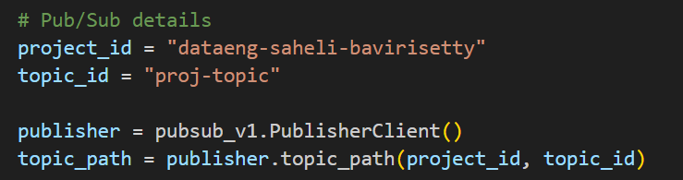
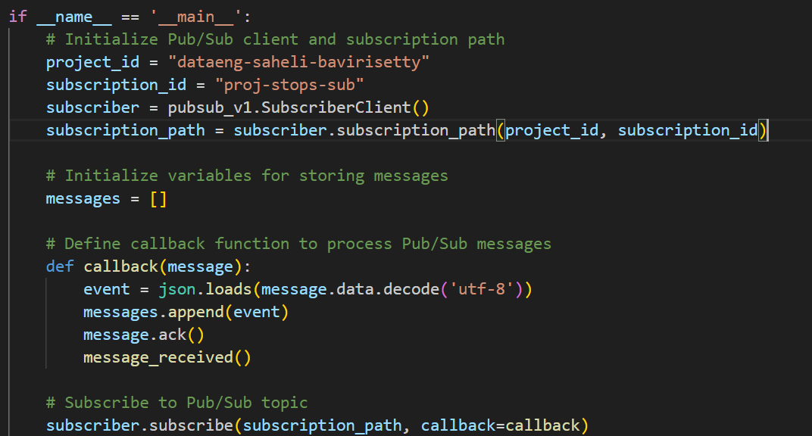
DATA TRANSPORT
Initializes a Google Cloud Pub/Sub Publisher Client to enable message publishing capabilities.
Constructs a unique topic path using project_id and topic_id for precise message routing within the Google Cloud project.
Nearly each day 300K to 350K records are pushed into topic.
We set up the project_id and subscription_id, and initializes a Subscriber Client to manage subscriptions and receive messages from Google Cloud Pub/Sub. Constructs a subscription_path to uniquely identify the subscription within the project.
We defined a callback function to process incoming messages by decoding them, parsing into JSON, appending to a list, acknowledging the message to prevent re-delivery, and triggering additional actions with message_received().
Subscribes to the Pub/Sub topic using subscriber.subscribe(), specifying the subscription_path and the callback function to handle each incoming message, enabling real-time data processing.
Srihari Tadala

Slide 9
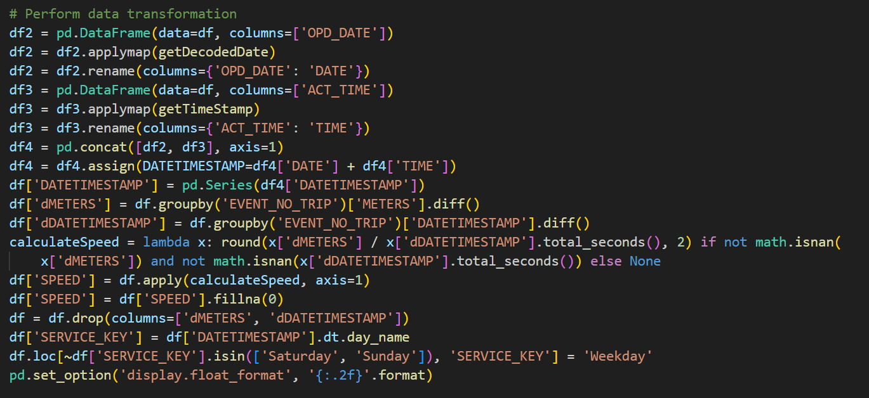
DATA TRANSFORMATION
We extracted and decoded date and time columns from OPD_DATE and ACT_TIME and created a combined 'DATETIMESTAMP' for each record.
Computes the difference in meters and timestamps for each trip, then calculates the speed, ensuring missing values are handled appropriately.
We defined a lambda function calculateSpeed to compute speed as dMETERS divided by the total seconds in dDATETIMESTAMP.
Applies this function across rows to create a 'SPEED' column, filling any NaN values in 'SPEED' with 0.
We assigned a 'SERVICE_KEY' based on the day of the week from 'DATETIMESTAMP'. 'Weekday' is assigned to all days except Saturday and Sunday.
Saheli

Slide 10
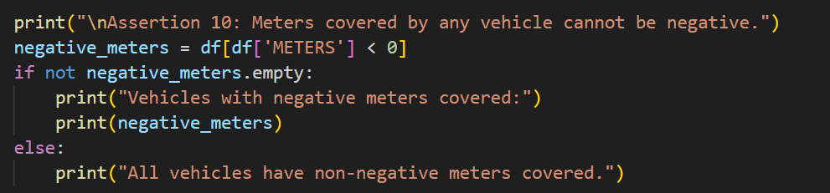
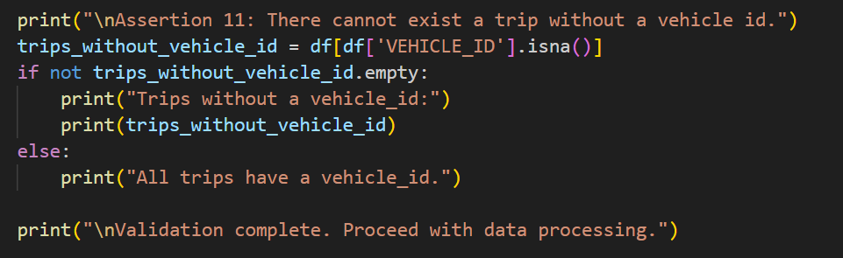
DATA VALIDATION
This assertion checks that the 'METERS' column contains only non-negative values, ensuring that the distance covered by any vehicle is not recorded as negative. If any vehicle has a negative value in the 'METERS' column, the details of such records are printed; otherwise, it confirms that all vehicles have non-negative meters covered.
This assertion ensures that every trip has an associated vehicle ID by checking for missing values in the 'VEHICLE_ID' column. If any trips are found without a vehicle ID, the details of these records are printed; otherwise, it confirms that all trips have a vehicle ID, allowing data processing to proceed.
Saheli

Slide 11
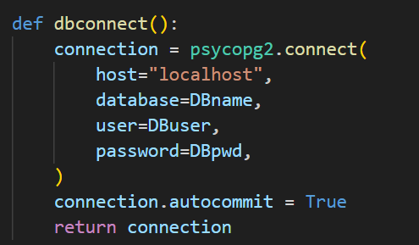
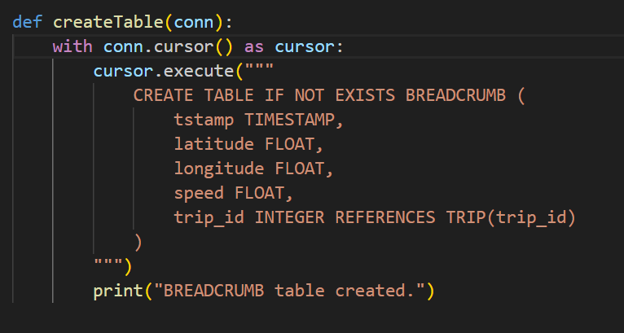
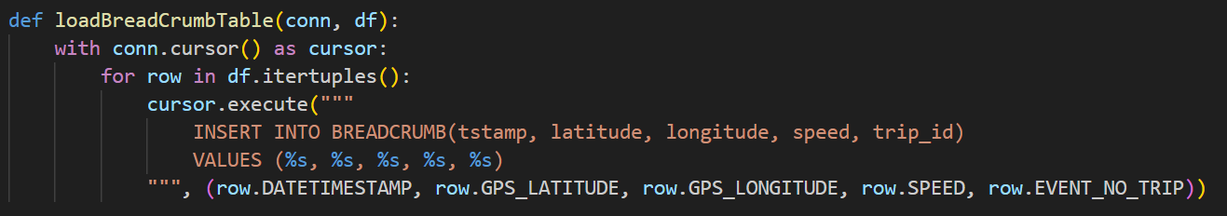
DATA STORAGE
This Python function establishes a connection to a PostgreSQL database using the psycopg2 library. It takes the database name (DBname), user (DBuser), and password (DBpwd) as parameters to authenticate and connect to the database. The autocommit attribute is set to True, ensuring that each SQL statement is automatically committed after execution.
This function creates a table named `BREADCRUMB` in a PostgreSQL database using the provided connection's cursor (`cursor`). The table includes columns for timestamp (`tstamp`), latitude (`latitude`), longitude (`longitude`), speed (`speed`), and a foreign key constraint (`trip_id`) referencing the `trip_id` column in the `TRIP` table. The `IF NOT EXISTS` clause ensures that the table is created only if it doesn't already exist, and a message is printed to confirm the successful creation of the `BREADCRUMB` table.
This function loads data into the `BREADCRUMB` table in a PostgreSQL database using the provided connection (`conn`) and a DataFrame (`df`) containing breadcrumb data. It iterates over each row in the DataFrame and inserts values into the `BREADCRUMB` table's corresponding columns (`tstamp`, `latitude`, `longitude`, `speed`, and `trip_id`) using parameterized queries for safe and efficient data insertion.
Saheli

Slide 12
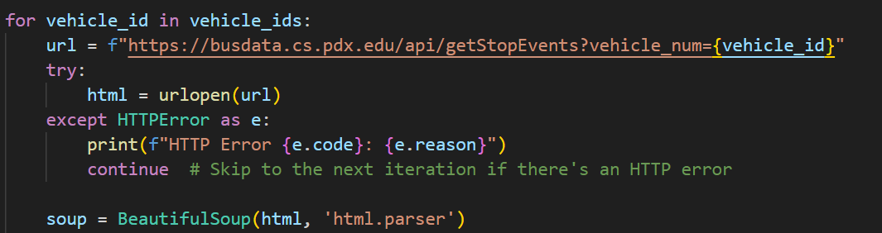
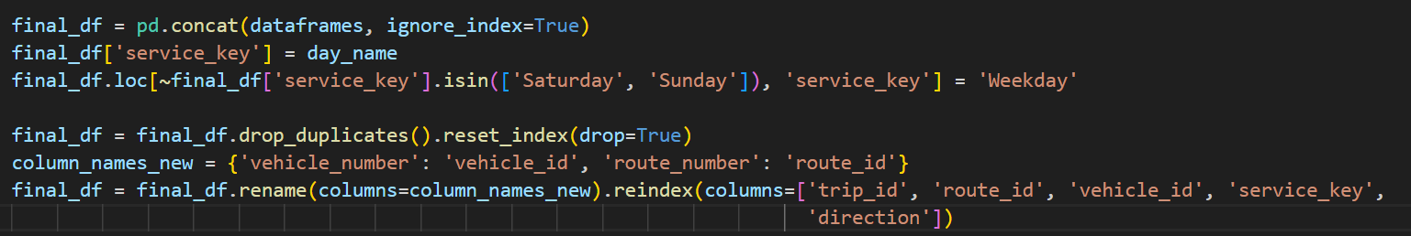
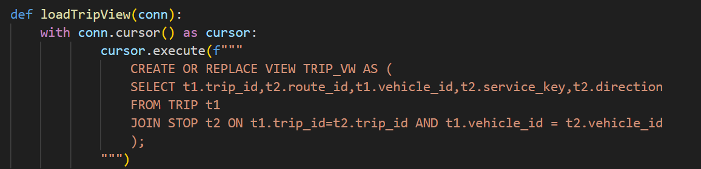
DATA INTEGRATION
In the previous steps we have trip data but we are not having data about route_id,service_key and direction so now we are collecting from the url https://busdata.cs.pdx.edu/api/getStopEvents?vehicle_num={vehicle_id} for all vehicles. From that URL using web scraping techniques we are collecting that data.
This function creates or replaces a view named TRIP_VW in a PostgreSQL database using the provided connection (conn) and cursor. The view is defined by a SQL query that selects specific columns (trip_id, route_id, vehicle_id, service_key, direction) from the TRIP and STOP tables, joining them on matching trip_id and vehicle_id values. The CREATE OR REPLACE VIEW statement ensures that the view is either created or updated if it already exists with the same name and structure.
Saheli

Slide 13
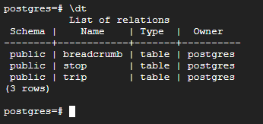
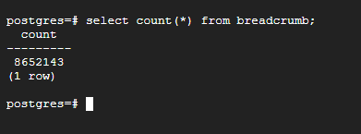
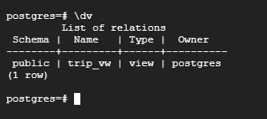
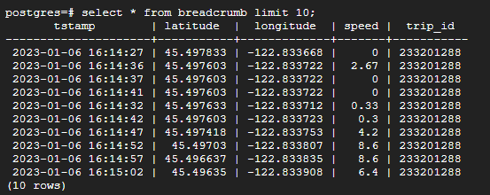
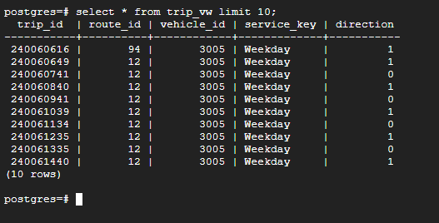
DATABASE
We have created 3 tables one for breadcrumb and other is stop and trip table and one view i.e trip view. In total we have collected 8652143 records of data.
The breadcrumb table contains column of timestamp, latitude, longitude, speed and trip_id which is foreign key reference to trip_id in trip table.
The trip view contains trip_id, route_id, vehicle_id, service_key, direction where this view is created by integrating trip table data with stops data.
Saheli

Slide 14
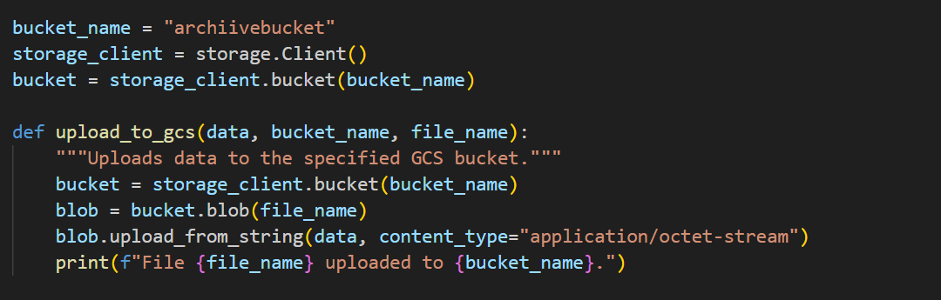
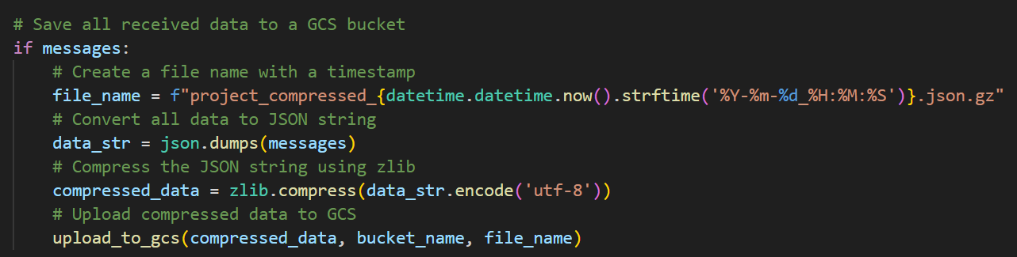
DATA MAINTENANCE
The Python function `upload_to_gcs` designed to upload data to Google Cloud Storage (GCS) buckets. It begins by initializing a storage client and identifying the target GCS bucket using the specified `bucket_name`. The function takes three arguments: the data to be uploaded (`data`), the name of the target bucket (`bucket_name`), and the desired filename for the uploaded data (`file_name`). Within the function, it fetches the bucket using the storage client, creates a blob (file) with the specified filename in the bucket, and uploads the data as a string to this blob, This functionality is particularly useful for automating data uploads to GCS within Python scripts or applications, facilitating efficient data management and storage on Google Cloud.
This code block checks if there are messages present in the `messages` variable. If messages exist, it proceeds to create a filename incorporating the current timestamp, formatted as 'project_stops_compressed_%Y-%m-%d_%H:%M:%S.json.gz'. It then converts all the message data into a JSON string using `json.dumps(messages)`. Next, the JSON string is compressed using zlib's `compress` function with UTF-8 encoding. Finally, the compressed data is uploaded to Google Cloud Storage (GCS) using the `upload_to_gcs` function, specifying the bucket name (`bucket_name`) and the generated filename for storage in GCS.
Saheli

Slide 15
DATA VISUALIZATIONS
VISUALIZATION 1
WHY
we want to identify significant speed changes. Specifically, it detects speed differences of over 20 units between consecutive records within a trip.The result is useful for identifying abrupt speed changes, such as acceleration, braking, or other anomalies during the trip. In order to achieve this we have used below query to retrieve the geographical locations (longitude and latitude) and speeds of a bus from the breadcrumb table,
QUERY
WITH SpeedChanges AS (SELECT longitude, latitude, trip_id, tstamp, speed, LAG(speed) OVER (PARTITION BY trip_id ORDER BY tstamp) AS previous_speed,speed - LAG(speed) OVER (PARTITION BY trip_id ORDER BY tstamp) AS speed_change FROM breadcrumb where latitude <> 'NaN' AND longitude <> 'NaN') SELECT longitude, latitude, speed FROM SpeedChanges WHERE ABS(speed_change) > 20;
VISUALIZATION 2
WHY
We want to Identify Busiest Routes During Peak Hours i.e. from morning 7:00 AM to 9:00 AM and evening 4:00 PM to 6:00 PM. The query below identifies the routes with the most data points during peak hours (e.g., 7-9 AM and 4-6 PM). We did visualization by collecting the latitude and longitude points of the routes which are busy during peak hours. By this visualization we understood the routes which are too busy during peak hours. From the observations I found the downtown is so busy during peak hours which is obvious.
QUERY
SELECT longitude, latitude, speed FROM breadcrumb b JOIN trip_vw t ON b.trip_id = t.trip_id WHERE (EXTRACT(HOUR FROM b.tstamp) BETWEEN 7 AND 9 OR EXTRACT(HOUR FROM b.tstamp) BETWEEN 16 AND 18) AND DATE(b.tstamp) = '2023-01 23' ;
Saheli

Slide 16
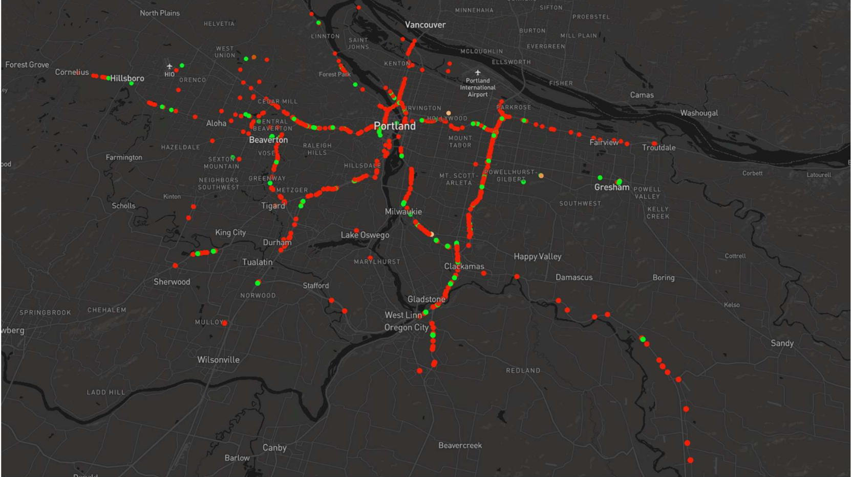
DATA VISUALIZATIONS 1
Saheli

Slide 17
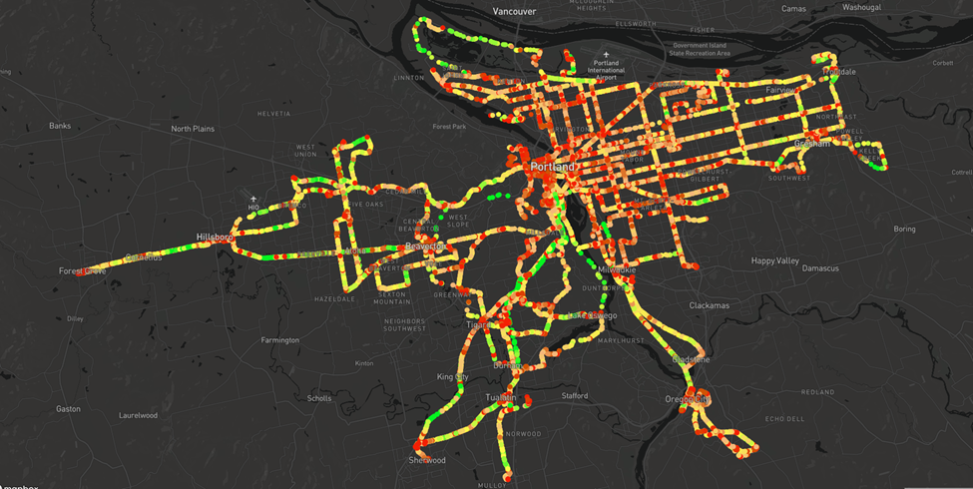
DATA VISUALIZATIONS 2
Saheli

Slide 18
CHALLENGES
I have faced difficulties in this particular step with consuming data that is producing by producer and learning about automation in GCP and setting up the crontab, system MD files to make the automation.
Managing and processing large volumes of real-time GPS and stop event data from transit systems presents significant challenge.
Web Scraping is little difficult and integrating became tricky.
Saheli

Slide 19
CONCLUSION
The data indicates fluctuating traffic patterns throughout the Portland metropolitan area. The selection of green, yellow, and red color coding serves to depict different speeds, signifying regions of smooth traffic flow (green), moderate slowing (yellow), and substantial congestion (red).
The impact of geographical limitations such as rivers and topography is clearly observable in the traffic flow, as congestion frequently arises at bridges and narrow passages.
Visualizations of significant changes in speed help identify spots where buses frequently slow down or speed up abruptly, which could be due to traffic conditions, road quality, or bus stop location
The data provides valuable insights into operational aspects, such as the effectiveness of the current routing and scheduling, highlighting opportunities for enhancing service reliability and passenger satisfaction.
The use of visual tools like Mapbox GL has effectively transformed raw transit data into actionable intelligence, making it easier to understand and communicate transit dynamics.
Saheli

Slide 20


THANK YOU

